Slide 1
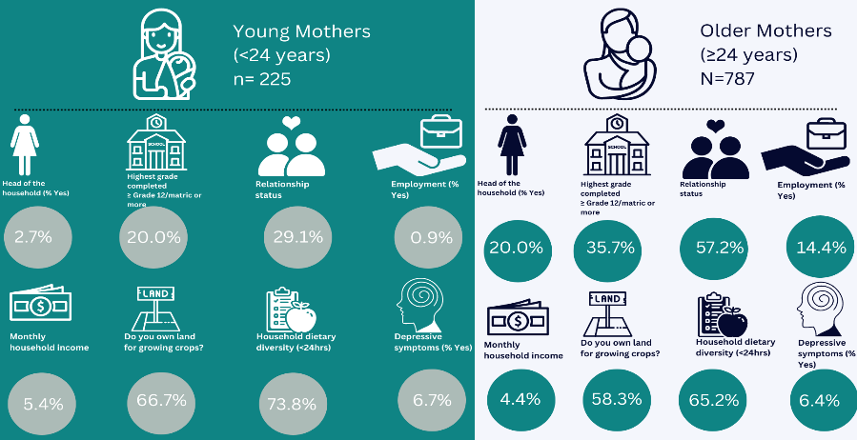












Association of maternal age with utilization of antenatal care services and knowledge of child development in rural Limpopo, South Africa
Nozipho Musakwa, Mhairi Maskew, Coetzee L, Moolla A, Maluleke V, Leshabane P , Robertson A, Marincowitz G, Zuckerman M, Railton J, Fink G, Hamer DH, Yousafzai A, Rockers PC, Denise Evans*
Background
Methods
Early pregnancy access to prenatal care is essential.
Research has linked a lack of antenatal services to a risk of maternal mortality.
Younger women typically share traits such as low socioeconomic position, lack of spousal support, work obligations, and unexpected pregnancies.
In South Africa more than a third of births occur in young mothers aged <24 years.
The influence of early maternal age and caregiving knowledge on pregnancy, birth, and early childhood outcomes is important.
We assessed two key behavioural outcomes for successful maternal care:
  Uptake and utilization of antenatal services; and
  Maternal knowledge of childhood development and early childhood developmental caregiving practices
We did a secondary data analysis of a cluster-randomized controlled trial to test the impact of a community health worker (CHW) delivered home visit intervention on child development in Limpopo Province, South Africa.
1,092 caregiver-child dyads (12/2018 – 03/2019)
The cross sectional study is based on data collected at baseline
Uptake of ANC was characterized by timing of entry to ANC and number of ANC visits
Data on maternal and infant characteristics were collected by CHWs through maternal self-report and the Road to Health booklet at the household post-birth.
The Caregiver Knowledge of Child Development Inventory was used to measure caregiver knowledge of ECD.
A log-binomial regression model to estimate the crude Prevalence Ratio (PR) with the corresponding 95% confidence interval to determine the association between characteristics at enrolment and maternal age (<24 vs >= 24 years
Results
Table 1: Antenatal service uptake
Fig 1: Characteristics of mother-infant dyads (n= 1012)
Younger <24 vs older mothers >24 years
Conclusion
Older age, being single, divorced or widowed and poor social support were also associated with poor uptake of ANC services, in keeping with other studies
Overall, knowledge of child-care and early childhood development was low across all participants, and we observed little difference by age group.
.
There is need for credible commitment, coordination and co-operation at district level to ensure that all mothers are informed and aware of the importance of ANC and early child care and development
devans@heroza.org
+27 10 001 7930

